Slide 1
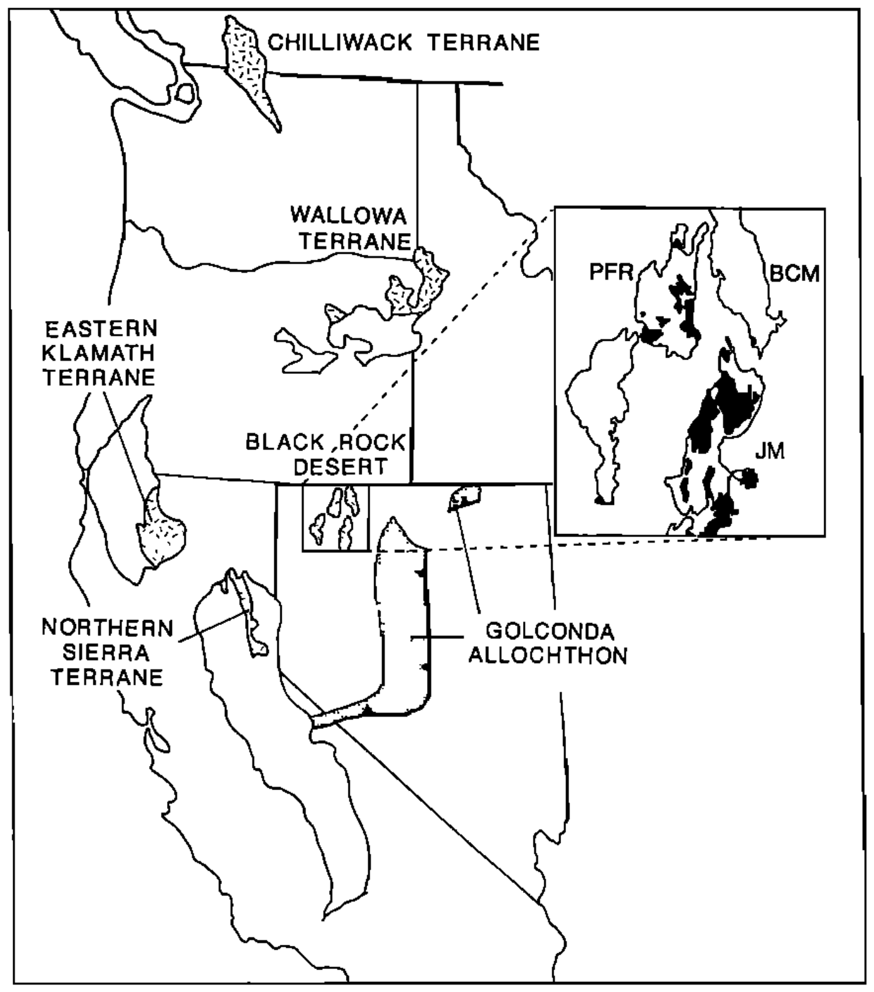
PERMO-TRIASSIC TECTONISM IN VOLCANIC ARC SEQUENCES OF THE WESTERN U.S. CORDILLERA AND IMPLICATIONS FOR THE SONOMA OROGENY
Sandra J. Wyld, 1991
Presented by Luke J Schranz

Slide 2
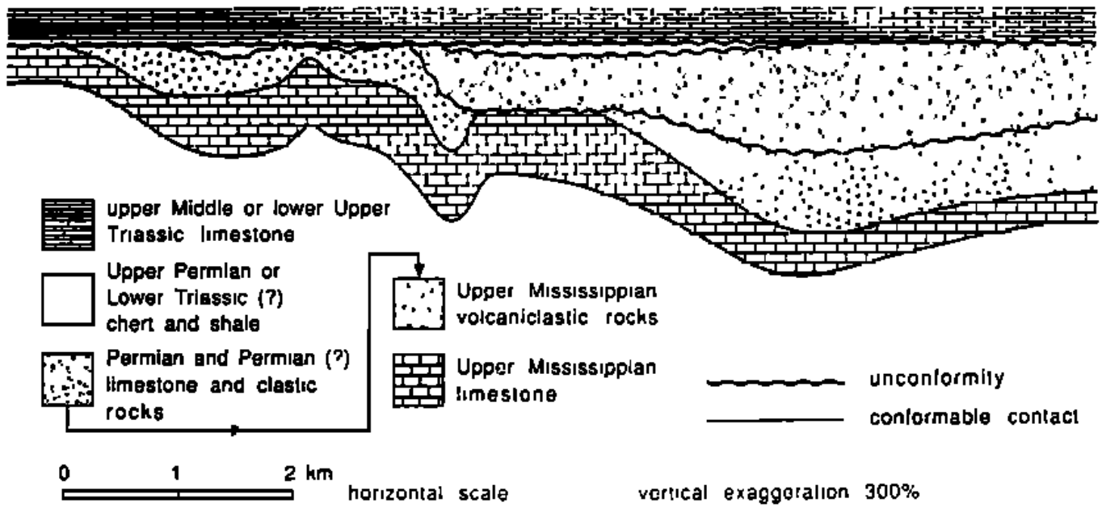
Example cross section from Pine Forest Range
Late Permian-Early Triassic deformation and uplift of units below chert sequence
Deep-water facies above unconformity

Slide 3
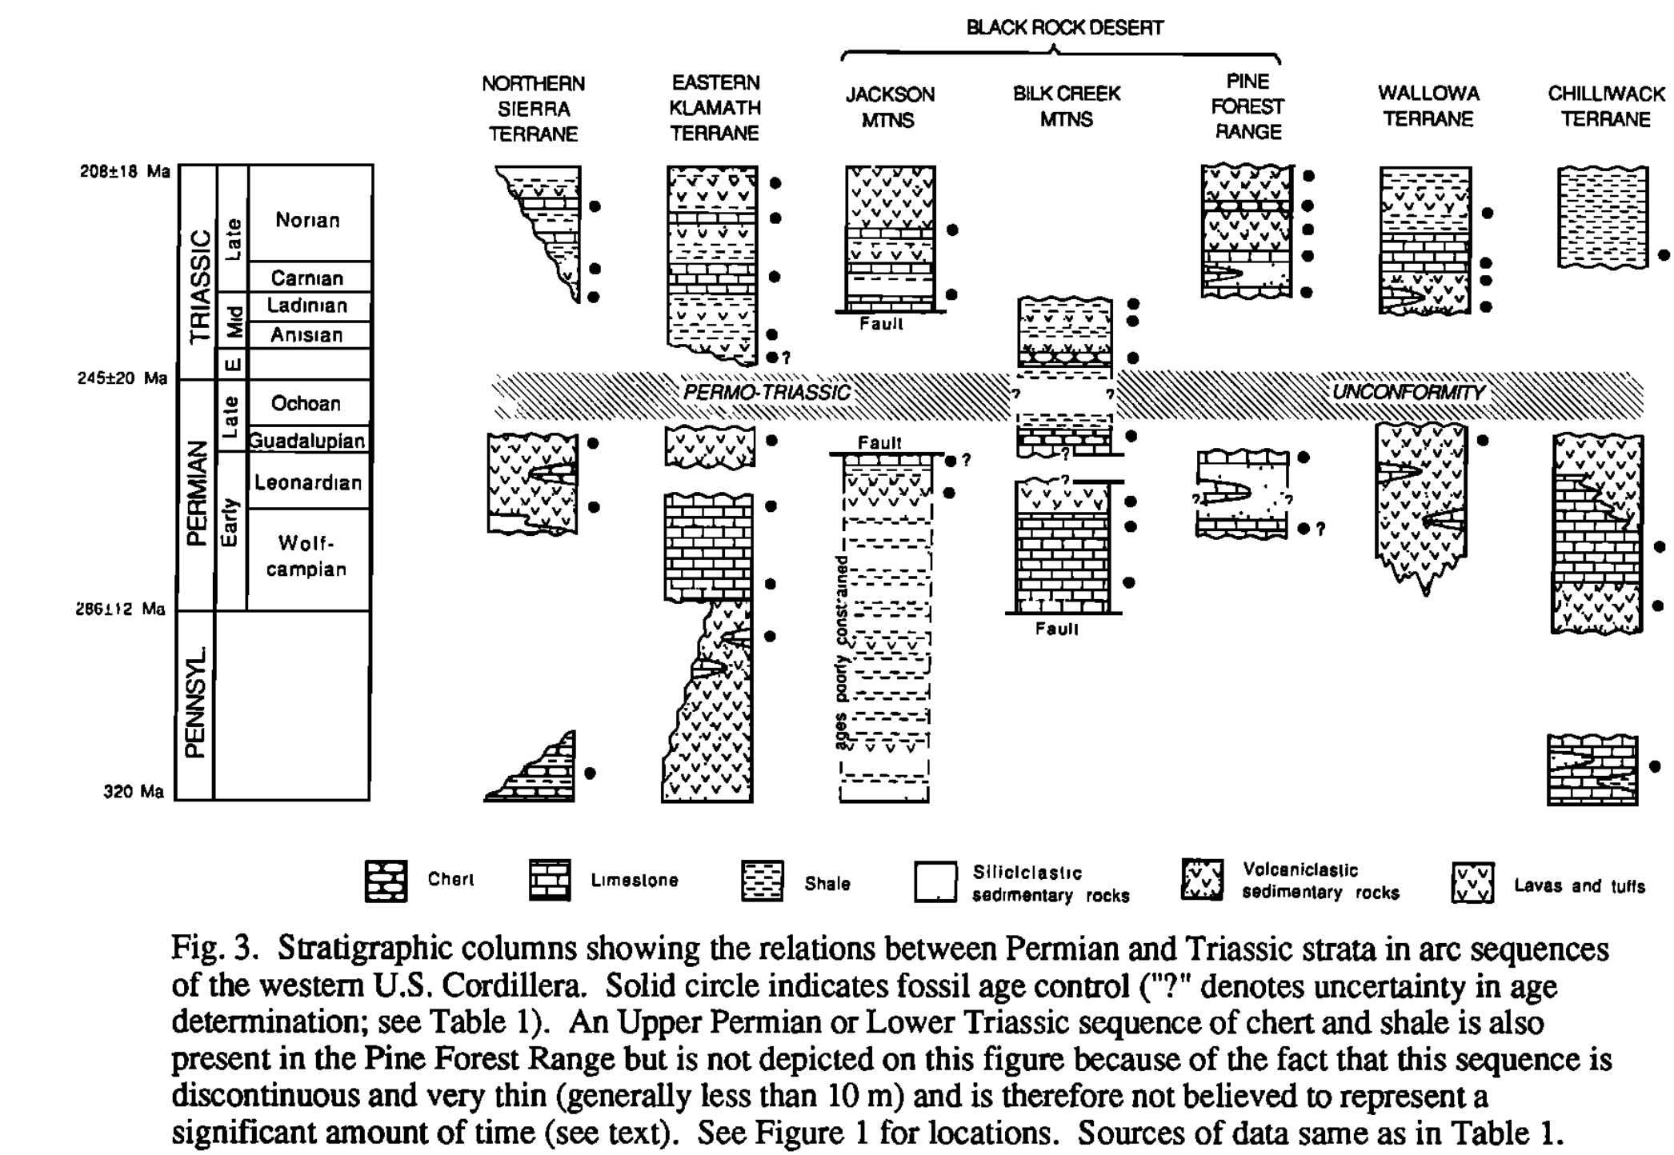

Slide 4
Permo-Triassic Unconformity
Largely ignored in previous studies
Disconformity in locations represents hiatus in sedimentation and a period of tectonic instability
Recognized in Cilliwack, Wallowa and northern Sierra terranes, but unclear (until now) in Klamath and Black Rock Desert (or possible condensed section here)
Similar timing to Golconda Allochthon

Slide 5
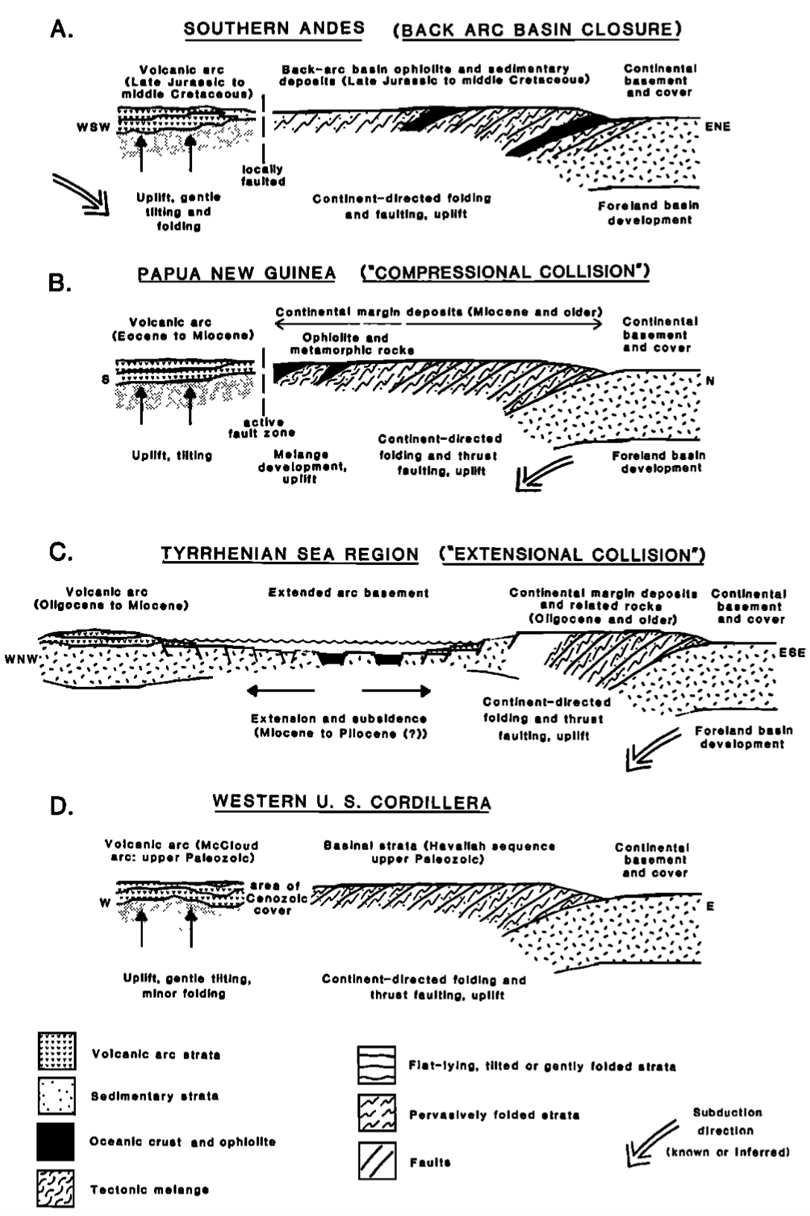
Lack of crustal shortening evidence
Still evidence of uplift
Either: shortening at depth or shortening ceased before before deformation
Lack of deformation is characteristic of Sonoma orogeny

Slide 6
w

